Slide 1
Module 1
Introduction

Slide 2
Information System
An information system (IS) is a coordinated set of components for collecting, storing, and processing data and for delivering information, knowledge, and digital products.
Components:
Hardware: The physical devices and equipment used in information systems.
Examples: Computers, servers, printers, network devices (routers, switches), storage devices (hard drives, SSDs), and input/output devices (keyboards, monitors).
Software: The programs and applications that run on the hardware.
Types:
System software: Operating systems (Windows, macOS, Linux).
Application software: Word processors, spreadsheets, database management systems, enterprise software (ERP, CRM).
Utility software: Antivirus programs, disk management tools.
Data: The core of the information system, consisting of raw facts and figures that are processed to produce meaningful information. Data is a critical component as it forms the basis for decision-making.
Types:
Databases: Structured collections of data.
Data warehouses: Central repositories of integrated data.
Big data: Large volumes of unstructured or semi-structured data from various sources.

Slide 3
4. People: The users who interact with the information system, from those who develop and maintain it to those who use it to perform tasks.
Categories:
IT professionals who develop and maintain the system : System analysts, programmers, network administrators, database administrators.
End-users who use the system to perform their jobs. : Employees, managers, customers, clients.
5. Processes: The procedures and rules that define how data is collected, processed, and distributed.
Examples:
Business processes: Workflow procedures, task sequences.
Information processes: Data entry, data processing, data analysis, data storage, and retrieval.
Security protocols: Access controls, encryption standards, backup procedures.
6. Networks: The communication systems that allow for data exchange and resource sharing among different devices and users within the information system. This includes both local area networks (LANs) and wide area networks (WANs), as well as the internet and intranets.
These components work together to support operations, management, and decision-making in an organization.
Information System

Slide 4
Types of Information System
Transaction Processing System (TPS):
Handles the collection, processing, and storage of transactions occurring within an organization.
Example: Point of Sale (POS) systems in retail stores.
Management Information System (MIS):
Provides information to support managerial decision-making at various levels of an organization.
Example: Sales reporting systems.
Decision Support System (DSS):
Assists in making decisions using data analysis and modeling.
Example: Financial modeling systems.
Executive Support System (ESS):
Helps senior management make strategic decisions.
Example: Dashboard reporting tools showing KPI for the CEO.
Enterprise Resource Planning (ERP):
Integrates business processes and data across an organization.
Example: SAP, Oracle ERP systems.

Slide 5
Types of Information System
Knowledge Management System (KMS):
Facilitates the collection, organization, and dissemination of knowledge within an organization.
Example: Intranet portals with wikis and forums.
Database Management System (DBMS):
Manages databases and provides functionalities for storing, retrieving, and updating data.
Example: MySQL, Oracle Database.
Geographic Information System (GIS):
Captures, stores, analyzes, and manages geographic and spatial data.
Example: Google Maps, ArcGIS.
Expert Systems (ES):
Mimics human expertise in a specific domain to solve problems.
Example: Medical diagnosis systems.
Office Automation Systems (OAS):
Automates routine office operations and supports communication and productivity.
Example: Email systems, document management system.

Slide 6
What is Information Retrieval?
Information retrieval (IR) is the process of obtaining information from a collection of documents or data sources that are relevant to an information need.
It involves searching for and retrieving information in response to a user's query or request.
IR systems are designed to help users find relevant information efficiently and effectively from large volumes of data.
Key Components of Information retrieval:
Query: A query is a formal request for information.
Document Collection: This refers to the set of documents or data sources that the IR system can search through to find relevant information.
Indexing: Indexing involves creating a structured representation (index) of the documents, which typically includes terms (keywords) and pointers to the documents where these terms appear.
Ranking: When a query is submitted, the IR system retrieves documents that are potentially relevant. These documents are then ranked based on their relevance to the query.
Retrieval Models: IR systems use various retrieval models to determine which documents are likely to be most relevant to a user's query.
User Interface: The interface through which users interact with the IR system, typically a search engine or a specialized application. It allows users to submit queries, view retrieved results, and navigate through documents.

Slide 7
Basic Concepts of Information Retrieval?
Information retrieval (IR) involves several fundamental concepts and principles that form the basis of how information is organized, searched, and retrieved. Here are some basic concepts in information retrieval:
1. Document
A document is a unit of information that can be retrieved from a collection based on a user's query. It can be a text file, web page, image, video, audio recording, or any other form of data.
2. Query
A query is a formal request for information submitted by the user to the information retrieval system. Queries typically consist of keywords, phrases, or natural language sentences that describe the user's information need.
3. Term
A term refers to a unit of information used in indexing and searching documents. It can be a word, phrase, or concept that represents a piece of information.
4. Index
An index is a data structure used to facilitate efficient retrieval of documents containing specific terms. It maps terms to the documents where they appear, along with additional metadata like term frequency and document IDs.

Slide 8
Basic Concepts of Information Retrieval?
5. Indexing
Indexing is the process of analyzing and storing documents to create an index. It involves text processing tasks such as tokenization (breaking text into tokens), stemming (reducing words to their base form), and stop-word removal (filtering out common words).
6. Retrieval Model
A retrieval model determines how documents are ranked and retrieved in response to a query.
Common retrieval models include:
Boolean Model: Retrieves documents based on Boolean logic (AND, OR, NOT) applied to terms in the query.
Vector Space Model: Represents documents and queries as vectors in a multi-dimensional space, using measures like TF-IDF to calculate similarity.
Probabilistic Model: Estimates the probability that a document is relevant to a query based on statistical analysis of term occurrences.
7. Relevance
Relevance refers to the extent to which a retrieved document meets the information needs expressed in a user's query. It is a crucial factor in ranking documents in IR systems.
8. Precision and Recall
Precision: The proportion of retrieved documents that are relevant to the query. High precision means a system retrieves mostly relevant documents.
Recall: The proportion of relevant documents that are retrieved by the system. High recall means a system retrieves most of the relevant documents.

Slide 9
Basic Concepts of Information Retrieval?
9. Ranking
Ranking refers to the process of ordering retrieved documents based on their relevance to the query. Documents are typically ranked from most relevant to least relevant using ranking algorithms.
10. Evaluation
Evaluation involves assessing the performance of an IR system using metrics such as precision, recall, and F1-score. It helps measure how well the system retrieves relevant information compared to a gold standard or user expectations.
11. User Interface
The user interface is the front-end through which users interact with an IR system. It allows users to submit queries, view retrieved results, and navigate through documents.
12. Feedback
User feedback is used to improve the relevance and effectiveness of an IR system over time. Relevance feedback allows users to indicate which retrieved documents are relevant or not, which can be used to refine future searches.
Understanding these concepts helps in designing, implementing, and evaluating effective IR systems that meet user information needs efficiently.

Slide 10
Information Retrieval Process
1. Information Need Identification
The process begins with identifying the information need of the user. This can be a specific query, a request for information on a particular topic, or a need for data related to a specific problem or decision.
Query Formulation: The user formulates their information need into a query. This can be done using keywords, phrases, natural language queries, or a combination thereof.
2. Document Collection
The next step involves determining the collection of documents or data sources from which information will be retrieved.
Document Selection: Depending on the scope of the query, the IR system selects relevant document collections. These collections can be databases, web pages, digital libraries, multimedia repositories, or any structured or unstructured data sources.
3. Indexing
Indexing is a critical process where documents are preprocessed to facilitate efficient retrieval.
Text Processing: Documents undergo text processing techniques such as tokenization (breaking text into tokens or terms), stemming (reducing words to their base or root form), and stop-word removal (filtering out common words like "and", "the", etc.).
Index Construction: An index is created based on the processed documents. This index typically maps terms (keywords) to the documents in which they appear, along with metadata like document IDs and frequency of occurrence of terms.

Slide 11
Information Retrieval Process
4. Query Processing
When a user submits a query, the IR system processes it to retrieve relevant documents.
Query Parsing: The system parses the query to identify keywords and other relevant components.
Matching: The system matches query terms with indexed terms to identify candidate documents that potentially contain the information sought by the user.
5. Ranking and Retrieval
Once candidate documents are identified, they are ranked based on their relevance to the query.
Relevance Ranking: Various algorithms are used to rank documents. Common methods include:
TF-IDF (Term Frequency-Inverse Document Frequency): Calculates the importance of a term in a document relative to its frequency across all documents.
Vector Space Model: Represents documents and queries as vectors in a multi-dimensional space and calculates similarity based on vector angles or distances.
Probabilistic Models: Estimate the probability that a document is relevant to a query based on statistical analysis of term occurrences.
Ranking Algorithms: These algorithms consider factors like term frequency, document length normalization, and other relevance indicators to rank documents.

Slide 12
Information Retrieval Process
6. Results Presentation
Finally, the IR system presents the ranked results to the user in a user-friendly format.
User Interface: The interface allows users to view retrieved documents, navigate through results, and refine queries if needed.
Snippet Generation: For text documents, the system may generate snippets (short excerpts) highlighting where the query terms appear in each document.
7. User Feedback
User feedback is crucial for improving the relevance and effectiveness of the IR system over time.
Relevance Feedback: Users may provide feedback on the relevance of retrieved documents, which can be used to adjust ranking algorithms or improve future retrieval performance.
8. Evaluation and Improvement
IR systems are evaluated based on metrics such as precision (proportion of retrieved documents that are relevant) and recall (proportion of relevant documents that are retrieved).
Performance Metrics: These metrics help assess and improve the effectiveness of the IR system in meeting user information needs.
In summary, the information retrieval process involves identifying user information needs, selecting relevant documents, indexing them for efficient searching, processing user queries, ranking retrieved documents based on relevance, presenting results to users, and incorporating feedback to enhance system performance. This process is foundational to various applications including search engines, digital libraries, and enterprise information systems.

Slide 13
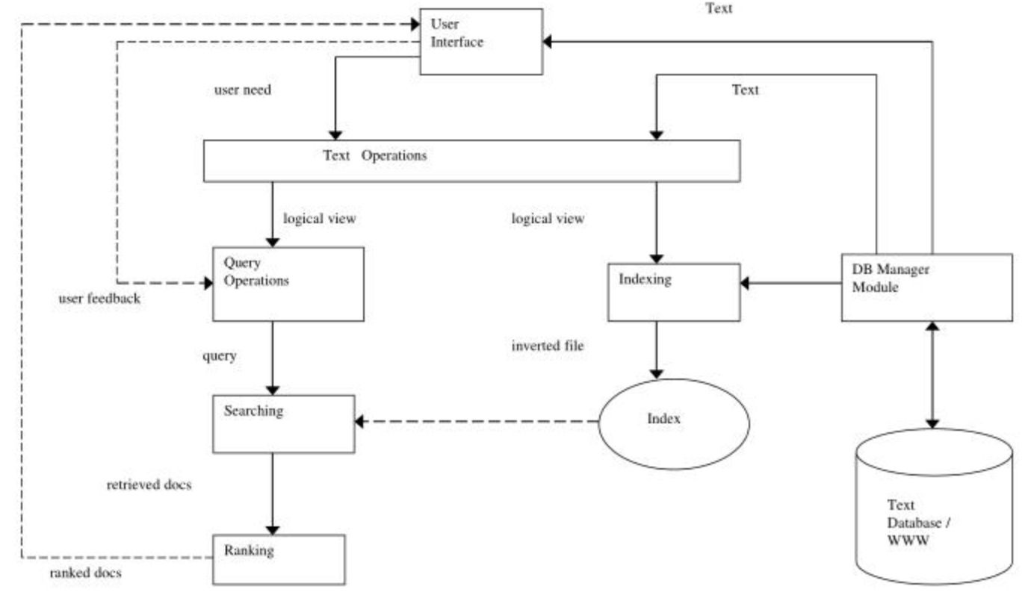
Information Retrieval Process

Slide 14
Motivation: Information Retrieval
The motivation for information retrieval (IR) stems from the fundamental human need to access and make use of information effectively and efficiently. Here are some key motivations:
Access to Knowledge: This facilitates learning, decision-making, problem-solving, and staying informed.
Efficiency: IR systems help users save time by retrieving relevant information in a timely manner,reducing manual search.
Decision Making: IR systems assist in retrieving relevant data and documents to support informed decision-making processes.
Research and Innovation: Researchers rely heavily on IR systems to access scientific papers, patents, and other scholarly works. This access (to existing knowledge) facilitates innovation.
Business Applications: In business, IR systems are used for market research, competitive analysis, customer support, and various other applications to support business operations.
Personal Use: Individuals use IR systems for everyday purposes such as finding information on hobbies, travel, health, and entertainment. Examples: Search engines and recommendation systems
Education: IR systems support educational activities by helping students and educators find learning resources, research materials, and academic papers.
Legal and Governmental Needs: Legal professionals and government agencies require IR systems to access legal precedents, legislative texts, case files, and other relevant documents.

Slide 15
Objectives of Information Retrieval System
The objectives of an Information Retrieval System (IRS) are focused on providing users with relevant information efficiently and effectively. The main objectives are:
Accuracy: To Ensure the retrieved information is precise and matches the user's query closely.
Relevance: To Provide information that is pertinent and useful to the user's needs.
Speed: To Retrieve and deliver information quickly to minimize user wait times.
Comprehensiveness: To Cover a wide range of topics and sources to provide thorough information retrieval options.
User-Friendliness: To Design the system to be easy to use, with intuitive interfaces and functionalities.
Scalability: To Handle increasing amounts of data and user queries without a decline in performance.
Efficiency: To Optimize resource usage, including processing power and storage, to retrieve information effectively.
Robustness: To Maintain functionality and performance despite errors, failures, or unexpected input.
Customization: To Allow personalization and tailoring of the information retrieval process to suit individual user preferences.
Security and Privacy: To Protect the data and ensure that sensitive information is retrieved and displayed securely, respecting user privacy.
Up-to-Date Information: To Ensure that the system provides the most current and relevant information available.
By meeting these objectives, an Information Retrieval System aims to enhance the user's ability to find and utilize information effectively for decision-making, research, and various other purposes.

Slide 16
Information Retrieval Vs. Data Retrieval
Information Retrieval
Definition: Information retrieval (IR) involves finding and retrieving unstructured or semi-structured information from large collections, such as documents, web pages, or multimedia content.
Focus: IR focuses on locating relevant information based on user queries, often dealing with textual data.
Techniques: Uses algorithms to rank and retrieve documents based on relevance, employing methods like keyword matching, natural language processing, and semantic analysis.
Output: Provides information that is often qualitative, such as a list of relevant documents, articles, or web pages that match the query.
Examples: Search engines (Google, Bing), digital libraries, and information systems for academic research.
Challenge: Handling the ambiguity and variability of natural language to understand the context and intent behind queries.

Slide 17
Information Retrieval Vs. Data Retrieval
Data Retrieval
Definition: Data retrieval involves extracting structured data from databases or other structured data sources using specific queries.
Focus: Data retrieval focuses on precise data extraction, often from databases, where the data is organized in a well-defined schema.
Techniques: Uses structured query languages (like SQL) to retrieve data based on exact matches to the query criteria.
Output: Provides quantitative data in a structured format, such as tables or records that meet the specified conditions.
Examples: Database management systems (DBMS) queries, reports generated from a relational database, and data extraction for analytics.
Challenge: Ensuring the accuracy and efficiency of data retrieval processes, especially with large volumes of data.
Data retrieval does not solve the problem of retrieving information about a subject or topic.

Slide 18
Information Retrieval Vs. Data Retrieval:Key Differences
Nature of Data: IR deals with unstructured or semi-structured data, while data retrieval deals with structured data.
Query Language: IR uses natural language queries, whereas data retrieval uses structured query languages.
Result Format: IR results are often documents or texts, while data retrieval results are structured data sets.
Relevance vs. Precision: IR focuses on relevance ranking, whereas data retrieval focuses on precision and exact matches.
IR is more about finding relevant documents or content in large, unstructured collections, while data retrieval is about extracting specific data from structured sources.

Slide 19
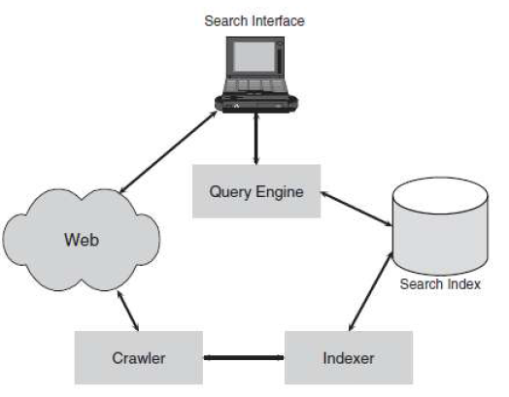
Search Engines and Browsers
Search engines and browsers are two fundamental tools for information retrieval on the internet, each serving distinct roles but often working in tandem.
Search Engines
Definition: Search engines are software systems designed to search for information on the web. They index vast amounts of web content and provide users with search results based on their queries.
Components:
Crawler/Spider: Automatically browses the web to collect and index new content.
Index: A massive database where the search engine stores information about web pages.
Search Algorithm: Determines the relevance of web pages to the user's query based on various factors like keywords, page rank, and user behavior.
User Interface: The search box where users input their queries and receive results.

Slide 20
Search Engines
Examples:
Google: The most widely used search engine, known for its advanced algorithms and vast index.
Bing: Microsoft's search engine, offering similar functionalities to Google.
Yahoo: Though less dominant now, it still provides a significant amount of web search functionality.
DuckDuckGo: Focuses on user privacy and does not track search activities.
Search Engines Advantages:
Efficient and quick retrieval of relevant information.
Handles large volumes of data.
Provides additional features like image search, video search, and news search.

Slide 21
Browsers
Definition: Browsers are software applications that allow users to access and navigate the internet.
They render web pages and provide a platform for running web applications.
Components:
User Interface: The window where users enter URLs and interact with web content.
Rendering Engine: Displays web pages by interpreting HTML, CSS, and JavaScript.
Networking: Handles internet communication protocols to fetch web content.
JavaScript Engine: Executes JavaScript code on web pages.
Data Storage: Manages cookies, local storage, and caching.
Examples:
Google Chrome: Known for its speed and extensive range of extensions.
Mozilla Firefox: Emphasizes privacy and customizability.
Safari: Apple's browser, optimized for macOS and iOS.
Microsoft Edge: Built on Chromium, known for integration with Windows.
Advantages:
Provides a user-friendly interface for accessing the web.
Supports a wide range of web applications.
Includes features like tabbed browsing, bookmarks, and extensions.

Slide 22
Interactions between Search Engines and Browsers
Integration: Most browsers have built-in search engine capabilities, allowing users to search directly from the address bar.
Default Search Engine: Browsers often come with a default search engine, but users can customize it.
Extensions: Browsers can use search engine extensions to enhance search capabilities and user experience.
Summary
Search Engines: Specialize in retrieving and ranking relevant information from the web based on user queries.
Browsers: Serve as the gateway to accessing and viewing web content, often integrating search engine functionality.
Together, search engines and browsers provide a comprehensive solution for information retrieval, making it easy for users to find and access the information they need on the internet.

